Slide 1


Student Attendance Management
Dept. of CSA – BCA
I Year – I Semester
Team Name: Open Source Crew
Venkatesh Sharma
Talluru Bharata
R.No: 2610520025
R.No: 2610520018
Manchala Keerthy
Mohammad Idris Ahmed
R.No: 2610520035
R.No: 2610520008
Notes:
Introduce the project and both members: Venkatesh Sharma and Talluru Bharata.

Slide 2



1. Introduction
Linux provides a powerful command-line environment where repetitive tasks can be automated with shell scripts. Bash is one of the most widely used shells.
This project is a Student Attendance Management system written in Bash. It adds students, marks daily Present / Absent attendance, shows attendance by date, and reports each student’s percentage and eligibility. All records are saved in text files.
Linux terminal
Runs fully from the command line
Bash scripting
Functions, loops, case menu
Text-file storage
Data stays after the program ends
Notes:
Linux and Bash background, then what this project does.

Slide 3


2. Problem Statement
The Challenge
The System Should
Maintaining attendance in paper registers is time-consuming. Counting present days, calculating the percentage and spotting students with shortage must be done by hand, which leads to counting errors and delays.
Store roll number and name of students
Record daily Present / Absent
Reject duplicate rolls and dates
Show attendance of a selected date
Calculate attendance percentage
Flag students below 75%
Keep records permanently in files
Notes:
Manual attendance is slow and error-prone; we need an automatic command-line tool.

Slide 4
3. Objectives
Understand the Linux terminal and basic Bash
Use variables and user input
Build a menu with while loop and case
1
2
3
Create and use Bash functions
Store and read data in text files
Use grep, cut, printf, date, touch
4
5
6
Calculate percentage with arithmetic
Validate input and handle errors
Deliver a working terminal demo
7
8
9
Notes:
Nine learning and project objectives.

Slide 5





4. Scope of the Project
PLATFORM
INTERFACE
INPUT
Ubuntu Linux / WSL
Command-line terminal with a numbered menu
Roll number, name, date, status (P/A)
OUTPUT
STORAGE
USERS
Student list, date-wise view, percentage report
students.txt and attendance.txt
Students or faculty demonstrating shell scripting
Version 1 manages one class using plain text files. No database or graphical interface.
Notes:
Academic demonstration; one class at a time; no database or GUI.

Slide 6





5. Existing System
Manual Process
Attendance is written in a paper register or entered in a spreadsheet. At month end the present days are counted and the percentage is worked out separately for every student.
Manual counting takes extra time
Arithmetic mistakes are possible
Shortage is detected late
Paper registers get lost and are hard to search
Notes:
Manual registers and spreadsheets; limitations listed.

Slide 7
6. Proposed System
Start the Bash script
Create data files if missing
Show menu, read choice
1
2
3
Add students to students.txt
Mark attendance as P or A
Save entries in attendance.txt
4
5
6
View attendance of any date
Generate report with % and status
Repeat until Exit
7
8
9
Notes:
Automated workflow using a Bash script.

Slide 8


7. Requirements
7.1 Hardware
7.2 Software
Computer or laptop
Minimum 4 GB RAM recommended
Keyboard and display
Ubuntu Linux or Ubuntu on WSL
Bash shell and a terminal
Text editor such as nano or vim
Utilities: grep, cut, printf, date, touch
No database or graphical software is required.
Notes:
Hardware and software needed.

Slide 9

8. System Design
8.1 Input
8.2 Processing
8.3 Output
Menu choice (1-6)
Roll number
Student name
Date (YYYY-MM-DD)
Status: P or A
Validate roll, date, status
Check duplicate entries
Append records to files
Count days with grep
Percentage = P × 100 / T
Compare with 75%
Student list
Date-wise attendance
Percentage report
ELIGIBLE / SHORTAGE
8.4 Criteria
75% or more → ELIGIBLE
Below 75% → SHORTAGE
No records → NO DATA
Notes:
Input, processing, output and the 75% criteria. Flowchart on the next slide.

Slide 10
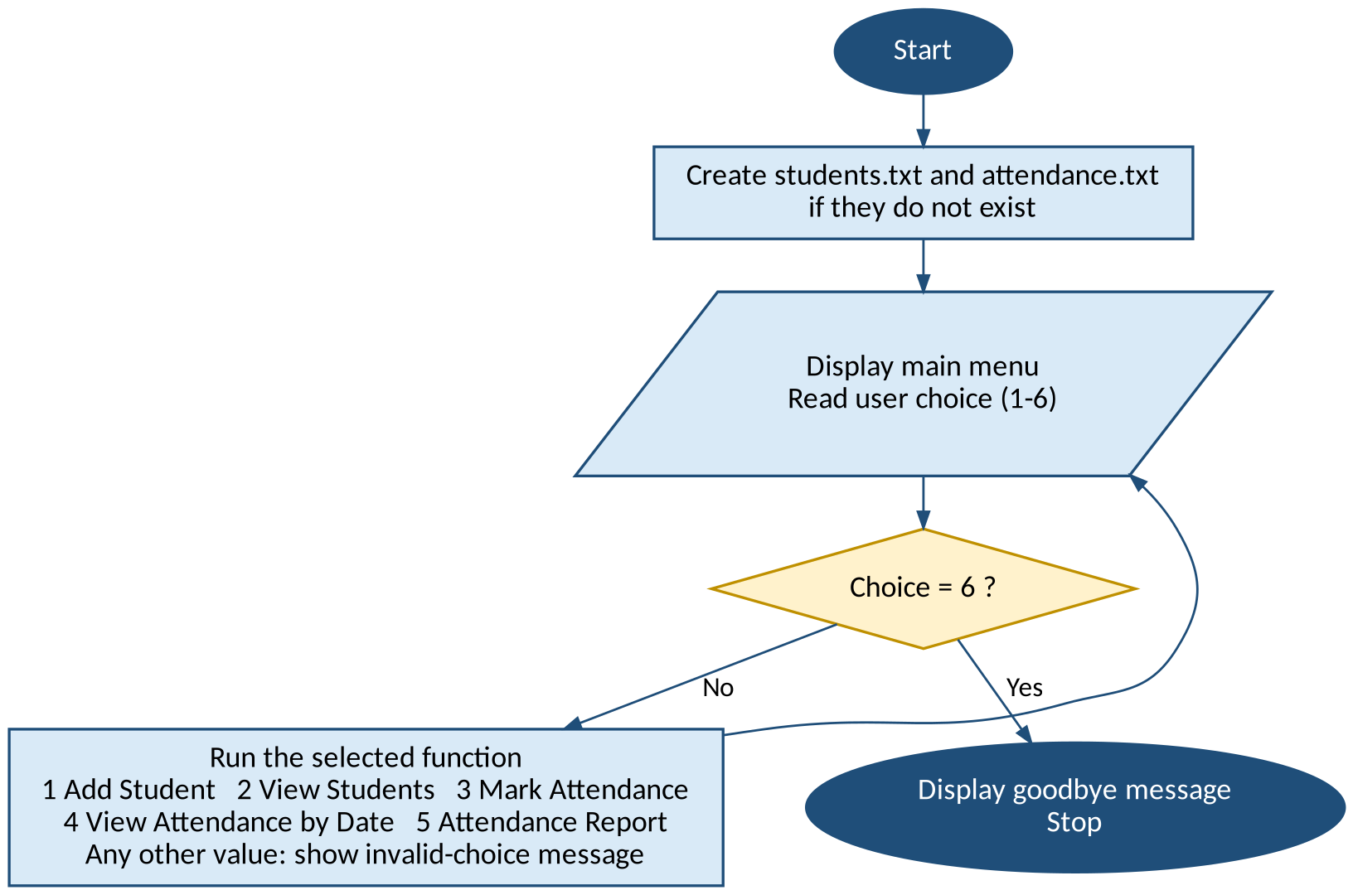
8. System Design: Process Flow
8.5 Data files
students.txt
101,Rahul
roll , name
attendance.txt
2026-10-05,101,P
date , roll , P or A
Notes:
Menu loop repeats until Exit. Data files are comma-separated text.

Slide 11
9. Algorithm
1
Start
7
Choice 4: show attendance of the entered date
2
Create students.txt and attendance.txt if missing
8
Choice 5: Percentage = Present × 100 / Total; 75 or more is ELIGIBLE, else SHORTAGE
3
Display menu and read choice
9
Choice 6: say goodbye and exit
4
Choice 1: validate roll, check duplicate, save student
10
Any other: show error, return to menu
5
Choice 2: display all students
11
Stop
6
Choice 3: read date, then P/A for each student, save
Notes:
Eleven-step algorithm of the program.

Slide 12
10. Implementation
1
10.1 Create the project directory
2
10.2 Create the Bash file
$ mkdir attendance_project
$ cd attendance_project
$ nano attendance.sh
3
10.3 Give execute permission
4
10.4 Run the project
$ chmod +x attendance.sh
$ ./attendance.sh
Notes:
Four terminal steps to set up and run.

Slide 13
11. Source Code (1 of 2)
#!/bin/bash
STUDENTS="students.txt"
ATTENDANCE="attendance.txt"
MIN_PERCENT=75
touch "$STUDENTS" "$ATTENDANCE"
add_student() {
read -p "Enter roll number: " roll
if grep -q "^$roll," "$STUDENTS"
then
echo "Roll number exists."
return
fi
read -p "Enter student name: " name
echo "$roll,$name" >> "$STUDENTS"
}
mark_attendance() {
read -p "Enter date: " date
while IFS=, read -r roll name <&3
do
read -p "$roll (P/A): " status
status=${status^^}
if [ "$status" = "P" ] ||
[ "$status" = "A" ]; then
echo "$date,$roll,$status" \
>> "$ATTENDANCE"
fi
done 3< "$STUDENTS"
}
Excerpts shown. Full script: attendance.sh
Notes:
Excerpts: setup, add_student and mark_attendance. The complete script is in attendance.sh and in the report.

Slide 14
11. Source Code (2 of 2)
view_by_date() {
read -p "Enter date: " date
grep "^$date," "$ATTENDANCE" |
while IFS=, read -r d roll status
do
name=$(grep "^$roll," "$STUDENTS" \
| cut -d, -f2)
printf "%-10s %-20s %s\n" \
"$roll" "$name" "$status"
done
}
# in attendance_report()
percent=$((present * 100 / total))
if [ "$percent" -ge "$MIN_PERCENT" ]
then status="ELIGIBLE"
else status="SHORTAGE"
fi
while true
do
# print the menu, then:
read -p "Enter choice (1-6): " choice
case $choice in
1) add_student ;;
2) view_students ;;
3) mark_attendance ;;
4) view_by_date ;;
5) attendance_report ;;
6) echo "Goodbye!"; exit 0 ;;
*) echo "Invalid choice." ;;
esac
done
Excerpts shown. Full script: attendance.sh
Notes:
Excerpts: view_by_date, percentage logic and the main menu loop.

Slide 15
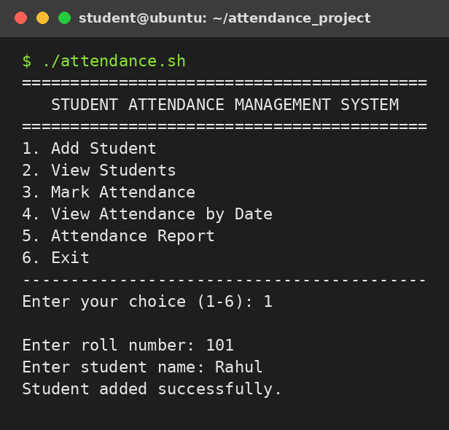
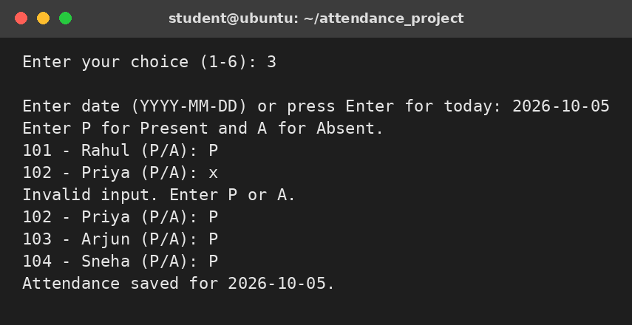
12. Sample Execution (1 of 2)
12.2 Mark Attendance (the entry "x" is rejected)
12.1 Menu and Add Student
Notes:
Adding a student and marking attendance, including an invalid entry that is rejected.

Slide 16
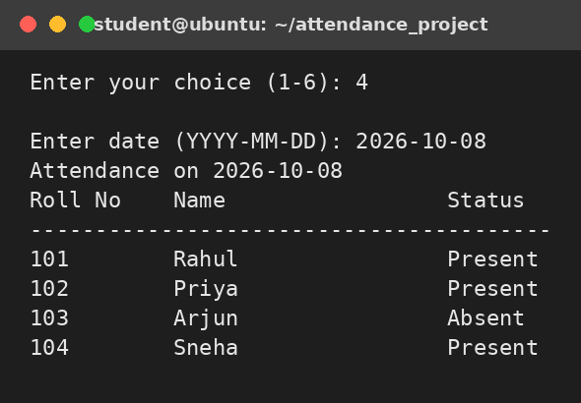
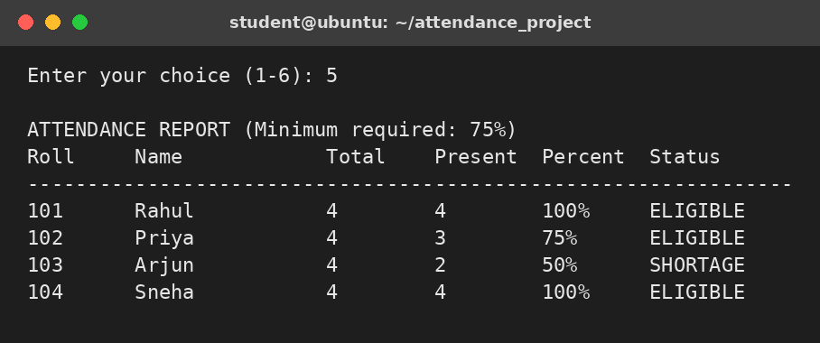
12. Sample Execution (2 of 2)
12.4 Attendance Report
12.3 View Attendance by Date
Minimum required attendance is 75%. Priya (75%) is ELIGIBLE; Arjun (50%) has SHORTAGE.
Notes:
View by date and the percentage report. Priya has exactly 75% so she is ELIGIBLE; Arjun has 50%.

Slide 17
13. Testing
10 / 10 passed
Test | Input / Action | Expected and actual result | Status
1 | Add student 101, Rahul | Student saved | Pass
2 | Add roll 101 again | Duplicate rejected | Pass
3 | Roll "10 1" (has a space) | Invalid roll rejected | Pass
4 | Status entered as "x" | Rejected, prompt repeats | Pass
5 | Mark 2026-10-05 twice | Duplicate date rejected | Pass
6 | View attendance of 2026-10-08 | Present / Absent table | Pass
7 | Rahul present 4 of 4 | 100%, ELIGIBLE | Pass
8 | Priya present 3 of 4 | 75%, ELIGIBLE | Pass
9 | Arjun present 2 of 4 | 50%, SHORTAGE | Pass
10 | Menu choice 9 | Invalid choice message | Pass
Notes:
All ten test cases passed.

Slide 18
14. Team Member Responsibilities
VENKATESH SHARMA
TALLURU BHARATA
Problem analysis
Bash logic and menu design
View attendance and report functions
Testing and sample outputs
Deliverables: Source code and algorithm
Deliverables: Test cases and sample outputs
MANCHALA KEERTHY
MOHAMMAD IDRIS AHMED
Add student and mark attendance functions
File handling
Documentation
Presentation
Deliverables: Data entry code and data files
Deliverables: Project report and slides
Notes:
Responsibilities as listed in the project report.

Slide 19


15. Advantages and Limitations
15.1 Advantages
15.2 Limitations
Simple and easy for beginners
Runs directly in the terminal
Reduces manual counting
Stores data permanently in files
Flags attendance shortage automatically
No database or extra software needed
One class at a time
No edit or delete option
Percentage is an integer value
Plain text files, no password
Date format checked, not the real calendar date
No graphical interface
Notes:
Strengths and current limits of version 1.

Slide 20





16. Future Enhancements
Update and delete students and attendance
Multiple classes, sections and subjects
Faculty login system
Export report to CSV or text
Cron job to send shortage reports
Store data in SQLite or MySQL
Graphical or web-based interface
Notes:
Possible next steps.

Slide 21

17. Learning Outcomes
After completing this project, students should be able to:
Navigate directories using Linux commands
Create and call functions
Create and edit files from the terminal
Read and write files with >>, grep, cut
Change permissions using chmod
Apply arithmetic and if-else logic
Write and run a Bash script
Validate input using regular expressions
Use variables and read for input
Test and debug a Bash program
Build a menu with while and case
Notes:
After this project students can do the following.

Slide 22
18. Conclusion
The Student Attendance Management system shows how Linux and Bash can solve a real academic problem. It combines variables, functions, loops, case statements, input validation and file handling.
As a beginner project it is a strong base for larger Linux work such as process management, cron automation and log analysis.
5
menu functions
2
text data files
75%
minimum attendance rule
Notes:
Summarise: simple Linux tools solve a real record-keeping problem.

Slide 23

19. References
Thank You
Linux man-pages: bash, grep, cut, printf, date, chmod, mkdir, cd, nano
GNU Bash Reference Manual
Ubuntu Linux documentation
Course notes and lab material from the faculty
Any questions?
VENKATESH SHARMA
TALLURU BHARATA
MANCHALA KEERTHY
MOHAMMAD IDRIS AHMED
Notes:
Thank the audience and invite questions.

